Slide 1
Do now
With your powerteam match the correct term to the definition
Terminology | Definition
Operationalise | A variable that could impact the results in research and is controlled for
Extraneous variable | The extent to how replicable a piece of research is and how consistent the results would be
Reliability | If the research is testable, measurable, and follows a method
Validity | Taking an abstract variable and making it testable and measurable
Scientific | The variable measured in research
Dependent variable | The extent to which your research measures what it intends to measure (how accurate it is)
Reminders:
Phones away
Bags on floor
Books out
Pens out
Whiteboard
Reminders
Next assessment Investigation 1: Mnemonics and memory

Slide 2
Answers
Terminology | Definition
Extraneous variable | A variable that could impact the results in research and is controlled for
Reliability | The extent to how replicable a piece of research is and how consistent the results would be
Scientific | If the research is testable, measurable, and follows a method
Operationalise | Taking an abstract variable and making it testable and measurable
Dependent variable | The variable measured in research
Validity | The extent to which your research measures what it intends to measure (how accurate it is)
Reminders:
Phones away
Bags on floor
Books out
Pens out
Reminders
Next assessment Investigation 1: Mnemonics and memory

Slide 3
Activate prior knowledge
What is the difference between a sample
and a population?
Notes:
Teacher questions:
What are the three divisions of the brain?
What is the oldest part of the brain?

Slide 4

Answer:
Activate Prior Knowledge
Sample:
In a study or experiment, the sample is the group that is a subset of the population (a larger group) being studied for research purposes
Population:
The group of *people to whom the findings from a research study apply

Slide 5
Activate prior knowledge
Write an operationalized hypothesis for:
Population: Teachers
IV: kind students
DV: mood
Notes:
Teacher questions:
What are the three divisions of the brain?
What is the oldest part of the brain?

Slide 6
Check your answer:
It is hypothesized that teachers who receive 10 kind words a day from students will demonstrate a happier mood than teachers who do not receive kind words from students, as measures by a self-report mood survey
*Your hypothesis may look different check ti has the same ingredients as above tho! (operatitonalsied IV and DV, compare to control.
Activate prior knowledge
Notes:
Teacher questions:
What are the three divisions of the brain?
What is the oldest part of the brain?

Slide 7
Activate prior knowledge
Define the term extraneous variables
Notes:
Teacher questions:
What are the three divisions of the brain?
What is the oldest part of the brain?

Slide 8
Activate prior knowledge
Answer:
Any variables (which is not the independent variable)
which may impact the dependent variable and thus
Must be controlled for
Notes:
Teacher questions:
What are the three divisions of the brain?
What is the oldest part of the brain?

Slide 9
Activate prior knowledge
With the below variables
Population: Teachers
IV: kind students
DV: mood
Come up with 3 extraneous variables
Notes:
Teacher questions:
What are the three divisions of the brain?
What is the oldest part of the brain?

Slide 10
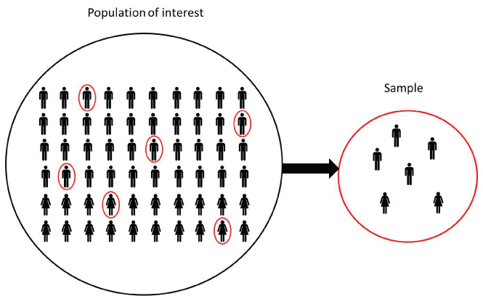
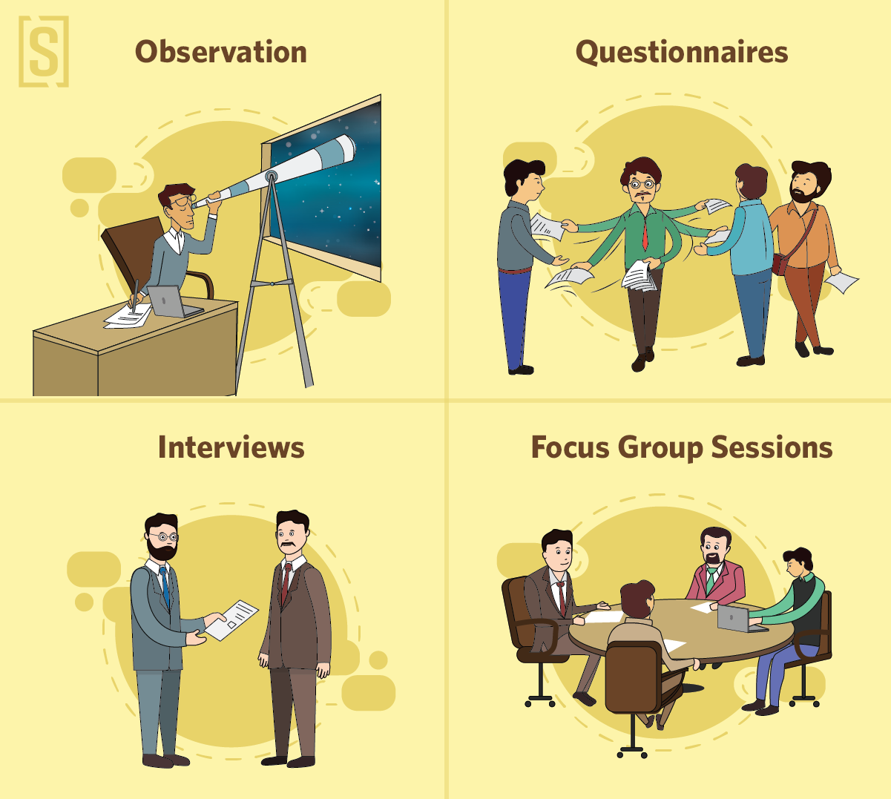
Research Design
Topics covered today:
Sampling methods
Data collection methods

Slide 11
Learning Intention
By the end of the lesson I will be able to:
Describe and evaluate the different sampling methods
Describe and evaluate the different data collection methods
Success Criteria
Everyone
A table to compare the different sampling and data collection methods
Practiced my skill of writing operationalized hypotheses

Slide 12
LO: Describe and evaluate sampling methods
TASK 1: Sampling methods
what will I be doing: Researching 2 of the below sampling methods, your partner will be researcher the other two sampling methods
Who with: In pairs of two
How long for: 15 minutes
What do I need to research: Click me!
What do I create: The table below
Vocabulary
Population: The group of people that the research is interested in Sample: The selected participants for the research
Concept Development
Sampling method | Description (how does it work) | Advantage | Disadvantages
Opportunity (convenience)
Volunteer
Stratified
Systematic
Notes:
https://www.simplypsychology.org/sampling.html

Slide 13
Check your learning
Explain how volunteer sampling works
Notes:
Teacher questions:
What are the three divisions of the brain?
What is the oldest part of the brain?

Slide 14
Check your learning
What are the strengths and limitations of
Opportunity sampling?
Notes:
Teacher questions:
What are the three divisions of the brain?
What is the oldest part of the brain?

Slide 15
Target population Joseph Banks Secondary College
Target population size: 1,800 (staff and students)
Use stratified sampling for this target population.
Researchers want a sample of 180 participants
Check your learning
Strata | Amount of people in total population
Year 7 - 10 | 1100
Year 11 - 12 | 540
Teaching and support | 110
Admin and cleaners | 50
Notes:
Teacher questions:
What are the three divisions of the brain?
What is the oldest part of the brain?

Slide 16
TASK 1: Data collection method
What will I be doing: Researching 2 of the below sampling methods, your partner will be researcher the other two sampling methods
Who with: In pairs of two
How long for: 15 minutes
What do I need to research:
What do I create: The table below
LO: Describe and evaluate sampling methods
Concept Development
Data collection | Description | Advantage | Disadvantages
Interview
Archival research
Case study
Survey
Observation

Slide 17
Check your learning
What type of data would an interview collect?
Subjective / Objective
Qualitative / Quantitative
Notes:
Teacher questions:
What are the three divisions of the brain?
What is the oldest part of the brain?

Slide 18
Check your learning
What are the disadvantages of case studies?
Notes:
Teacher questions:
What are the three divisions of the brain?
What is the oldest part of the brain?

Slide 19

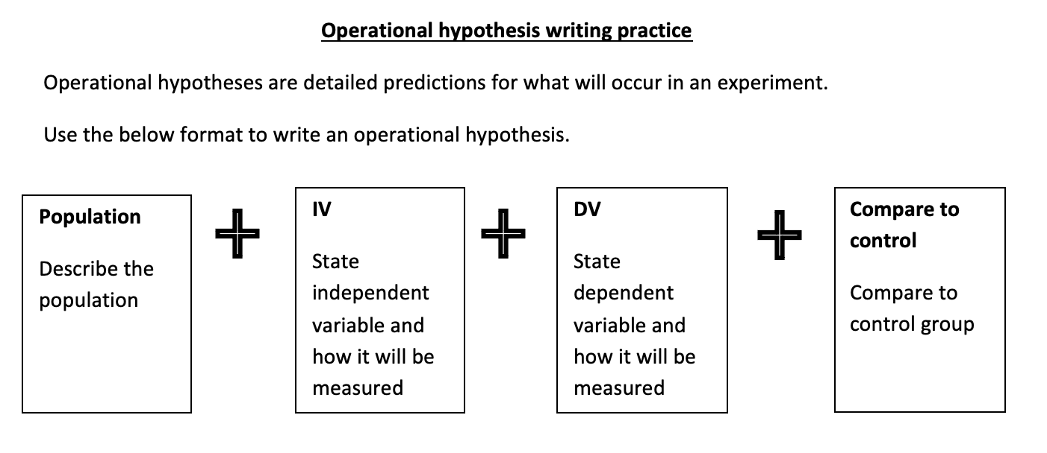
Skill practice
Task: Open up the operational hypothesis worksheet.
Pick out the population and variables and formulate a hypotheses
Notes:
Teacher questions:
What are the three divisions of the brain?
What is the oldest part of the brain?

Slide 20

Exit Ticket
Fist to five and explain to partner

